Slide 1
Glider Final Design Package
Design and Presentation by:
Madison Dube, Alexander Larson, James Guthrie, Samuel D’Souza, Abdullah Almugairin, Abdulla Al Ameri

Slide 2
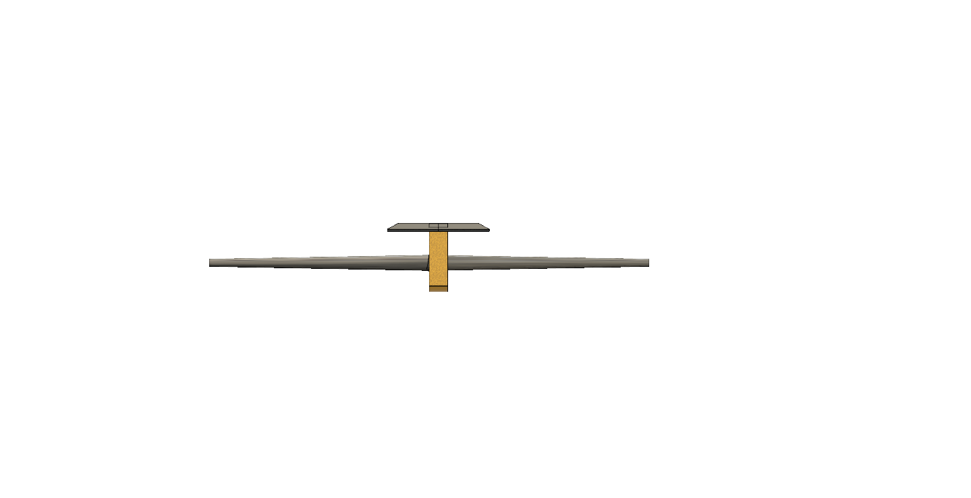
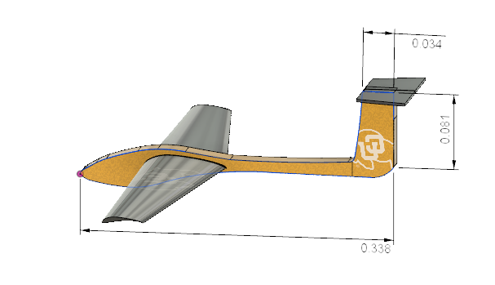
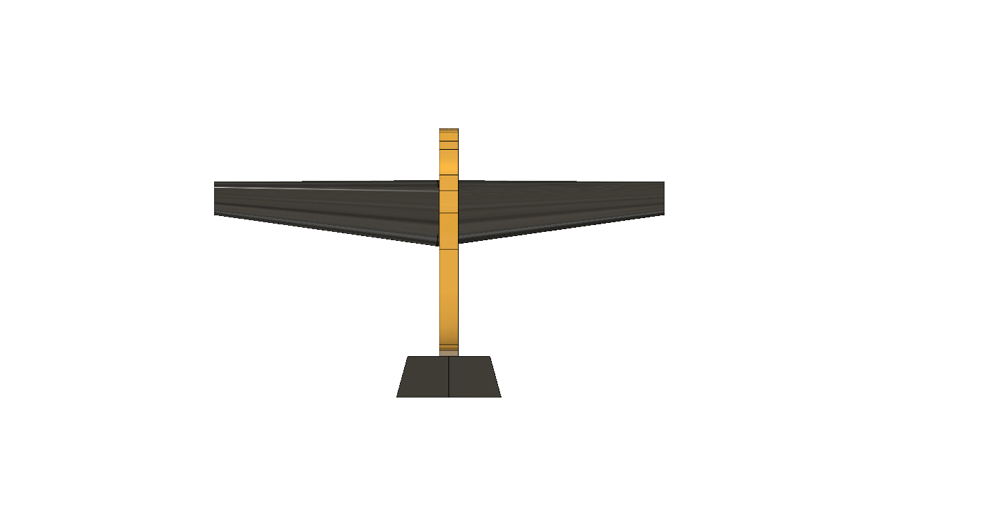
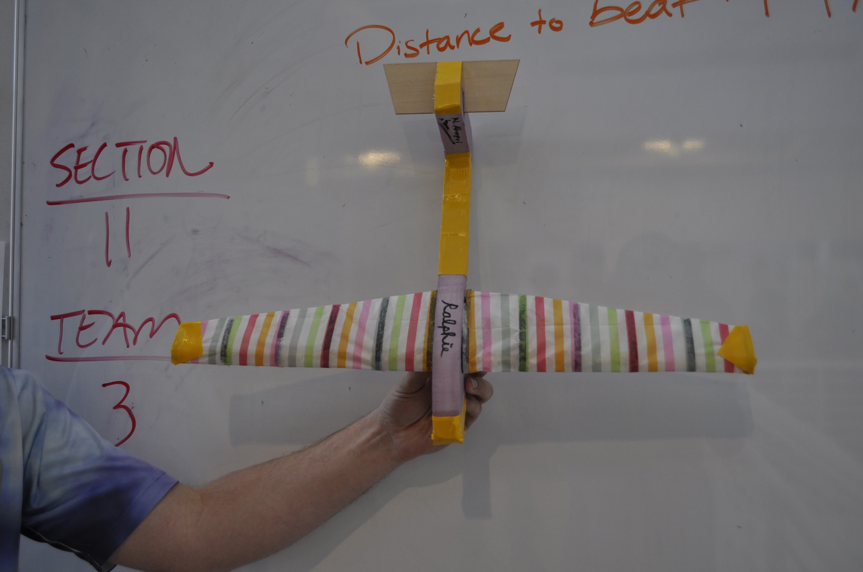
Finalized Design: (in meters).
0.6
0.27
0.14

Slide 3
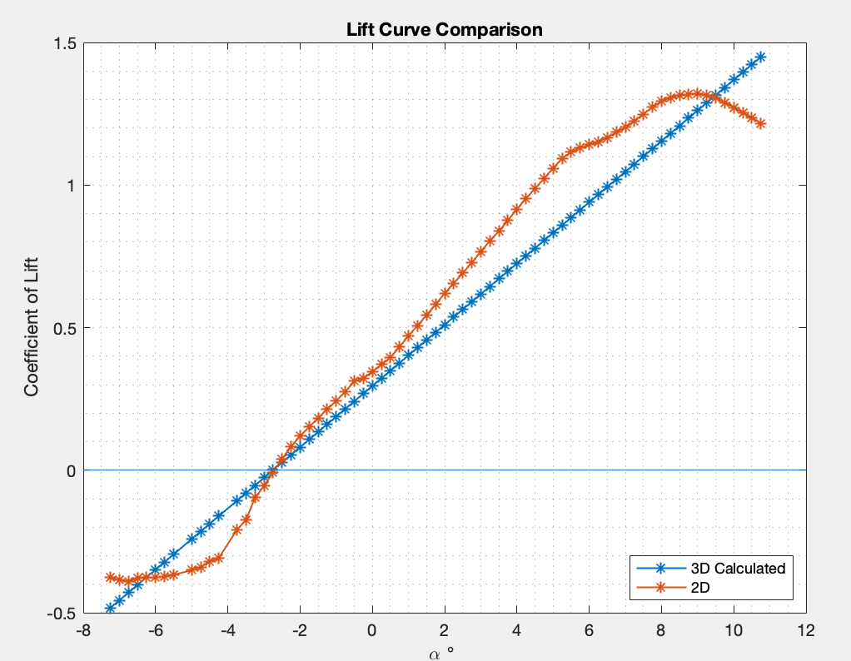
Lift curve
Airfoil: S1223 (s1223-il)
Re = 50,000

Slide 4
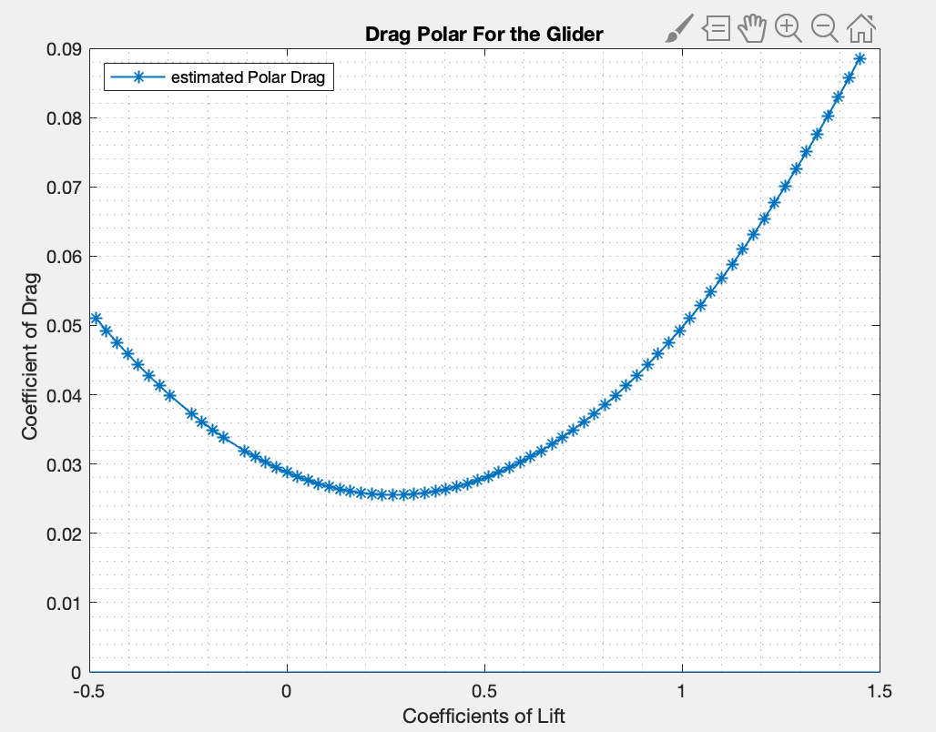
Drag Polar

Slide 5
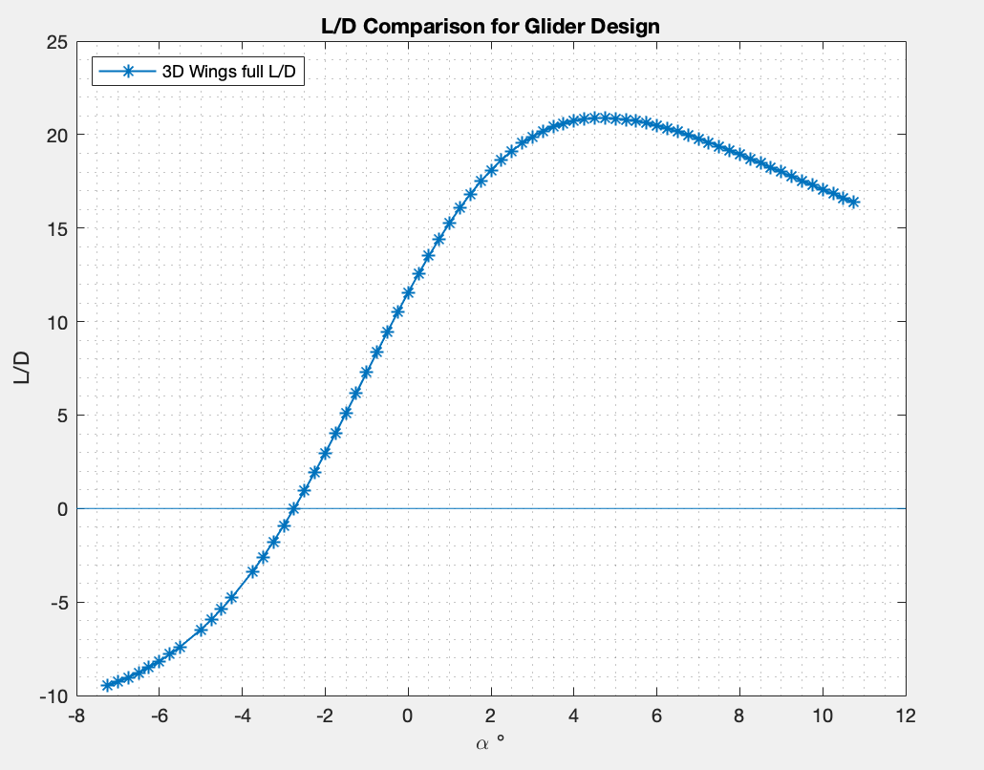
L/D Curve

Slide 6
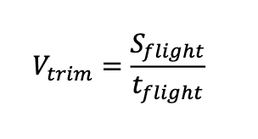
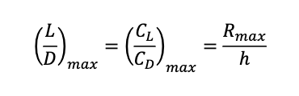
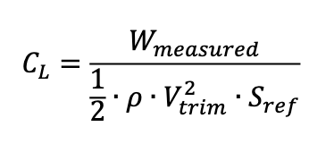
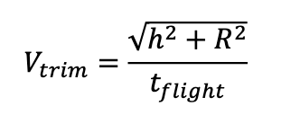
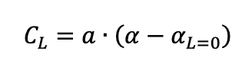
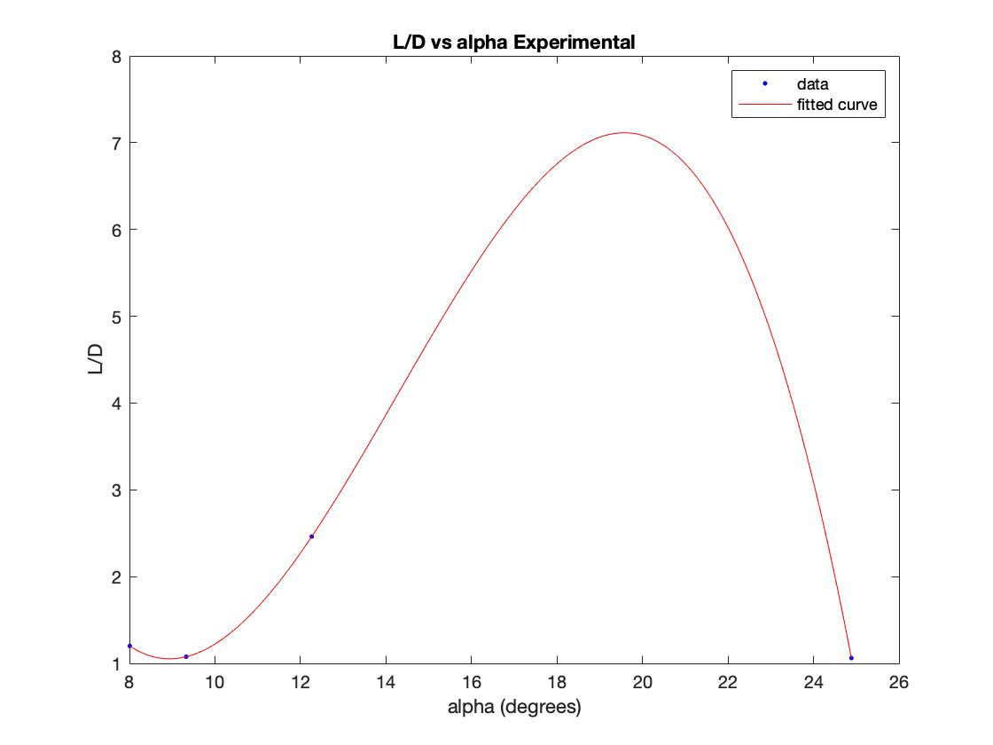
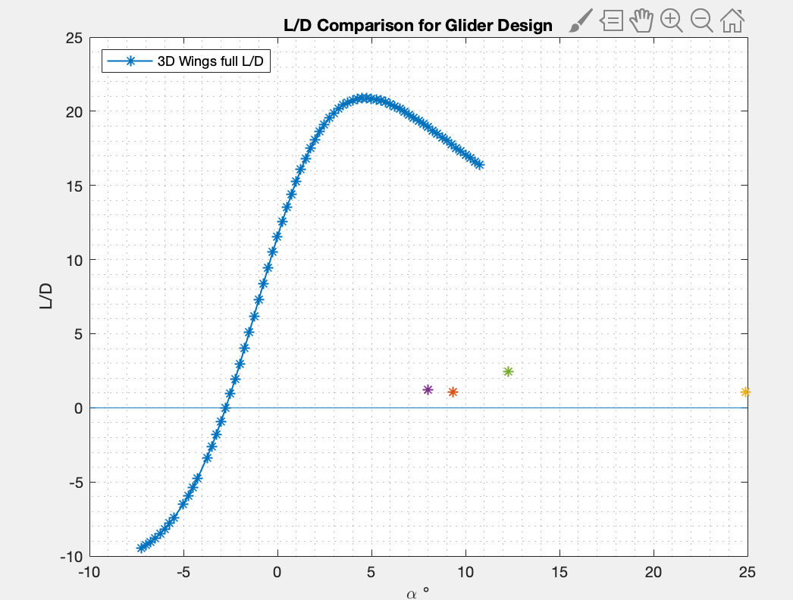

Slide 7
System Requirements 5 | Threshold | Design | Flight
Max Glide Range (m) | 40 - 80 | 133 | 16.1
Max Glide Range Velocity (m/s) (L/D max) | 3 - 7 | 4.68 | 2.12
Stall Velocity (m/s) |  | 4.5 (based on theoretical CL)
Elevator Pitch Control (degrees) | +/- 8 | +/- 15 | +/- 10
Longitudinal Stability (xcg location) | 0.0c - 0.3c | 0.25c | 0.2c
Longitudinal Stability (horizontal tail volume) | 0.3 - 0.6 | 0.553 | .585
Lateral Stability (Vert tail volume/spiral) | 0.02 - 0.05 | .038 | 0.363
Maximum Wingspan (m) | 0.9 | 0.6 | 0.555
Total Mass (kg) | 0.040 - 0.080 | 0.053 | 0.063
Unit Cost (dollars) | 20 - 30 | 15 | 28

Slide 8
Glider Performance
ALEX WILL TALK ABOUT THIS!!!
Investigating test flights of our plane we can analyze what went wrong with our calculations and furthermore the build

Slide 9
Valuable Lessons
How not to compromise total design to fit one design parameter
More iterations of manufacturing
Rethink fuselage design
Wrong calculated trim velocity
Adding more tape to the tail, have a checklist for each flight
Theoretical Calculations go out the door once you start manufacturing
Plan for manufacturing to some degree initially, and work on refining the design through theoretical calculations

Slide 10
References
-Brandt, S., Mah, J., Jodeh, N., US Air Force Academy, Aero 315 RASP Project, Summer 2010
-G.K. Ananda, P.P. Sukumar, M.S. Selig, Measured aerodynamic characteristics of wings at
low Reynolds numbers, Aerospace Science and Technology, Volume 42, 2015…
-Anderson, J. D., Introduction to Flight, 8th Ed., McGraw Hill (2012).
-Brandt, S, Introduction to Aeronautics: A Design Perspective, 2nd Ed, AIAA (2004).
-Mark Drela, Steven Hall, Paul Lagace, Ingrid Lundqvist, Gustaf Naeser, Heidi Perry, Raúl
Radovitzky, Ian Waitz, Peter Young, and Jennifer Craig. 16.01 Unified Engineering I, II, III, & IV. Fall
2005-Spring 2006. Massachusetts Institute of Technology: MIT OpenCourseWare,
https://ocw.mit.edu. License: Creative Commons BY-NC-SA.
-Drela, M., XFOIL Program, MIT, https://web.mit.edu/drela/Public/web/xfoil/
-Raymer, D. P., Aircraft Design: A Conceptual Approach, 2nd Ed., AIAA Inc., Chap. 12 (2012).
-Roskam, J., Airplane Design Part II: Preliminary Configuration Design and Integration of
the Propulsion System, Chapter 12, DARCorporation (1997).
-Roskam, J., Airplane Design Part VI: Preliminary Calculation of Aerodynamic, Thrust, and
Power Characteristics, Chapter 5, DARCorporation (1997).
-Selig, M., University of Illinois at Urbana-Champaign Applied Aerodynamics Group, https://m-
selig.ae.illinois.edu/index.html

